Slide 1
MAS512 Assignment 2
Group 5
Q1: Camera depth and neural network
Q2: Lidar centre and KISS-ICP
Q3: Camera-Lidar fusion on KITTI
Q4: Slip estimation with a lidar and wheel encoders

Slide 2
Q1: Camera image to 3D position
1 Detect
YOLO box centre (u, v)
2 Add depth
depth image gives Z
3 Back-project
(u, v, Z) → (X, Y, Z)
4 Learn
network maps one camera model to another
(a) Pixel and depth to 3D with a pinhole model: X = (u − cx) Z / fx, Y = (v − cy) Z / fy
(b) Three sets of intrinsics (o1, o2, o3) give three 3D trajectories of the same load
(c) The load swings in a plane: fitted with SVD, and a circle fit gives the pendulum radius
(d) A small neural network learns to turn o1 into o2 (called o2*)
(e) Euclidean error between o2* and o2 shows how well it learned

Slide 3
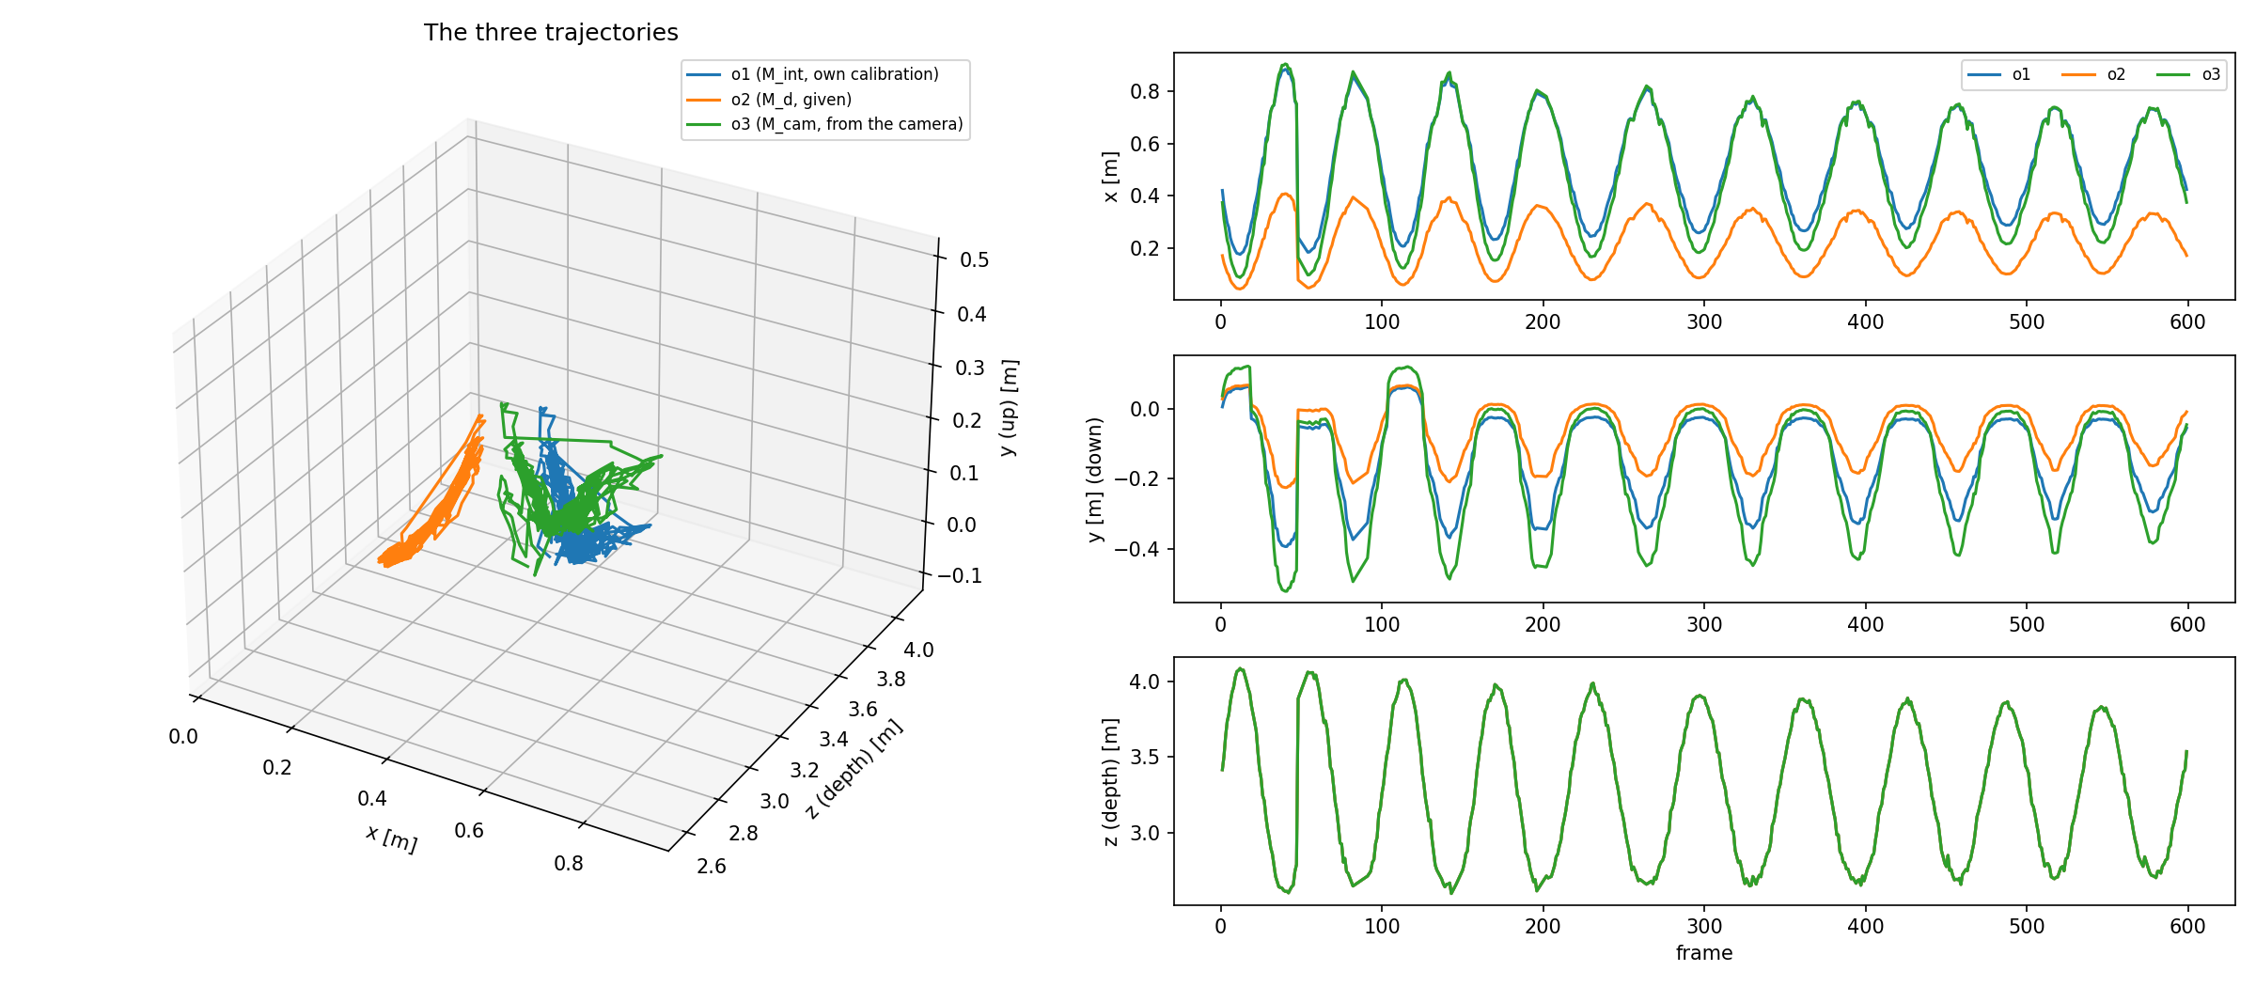
Q1(a)(b): Three camera matrices
 | fx | fy | cx | cy
o1 own calibration | 661.8 | 831.4 | 310.8 | 244.6
o2 given (M_d) | 1342 | 1342 | 325 | 235
o3 camera factory | 601.4 | 601.5 | 326.4 | 239.3
• o1: chessboard (9×6 corners, 27 mm squares), OpenCV
• o2: given in the assignment
• o3: factory values read from the camera
• 552 of 600 frames had both a detection and a depth value
• Z comes straight from the depth image, so it is the same for all three. Only x and y differ
The three trajectories, 3D and per axis

Slide 4
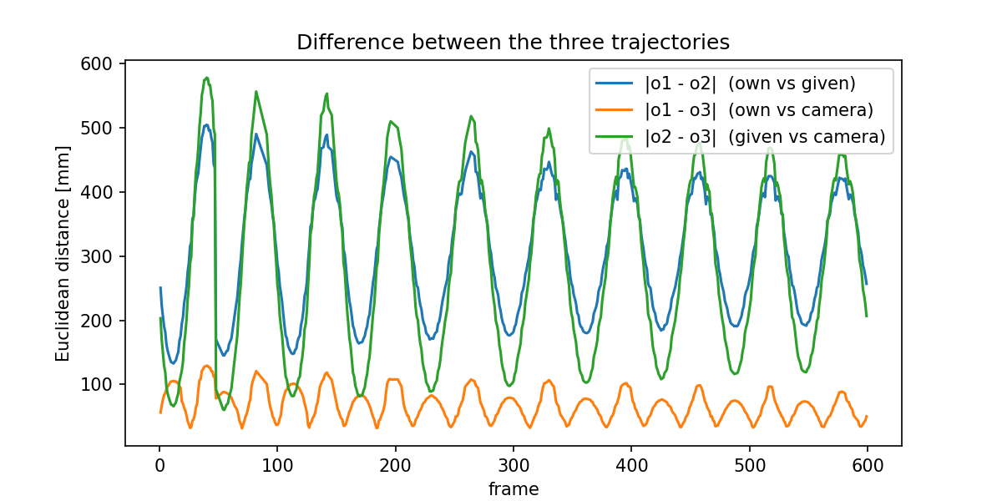
Q1(b): How far apart are they?
Pair | Mean | Max
o1 vs o2 (own vs given) | 301 mm | 504 mm
o1 vs o3 (own vs camera) | 67 mm | 129 mm
o2 vs o3 (given vs camera) | 278 mm | 578 mm
• Own calibration and the camera's factory values agree: both have a focal length around 600–800 px
• The given matrix (f = 1342) makes x and y about half as large, so it is far from both
• The jump near frame 47 is in all three: it comes from the detection, not the matrices
Distance between the trajectories, per frame

Slide 5
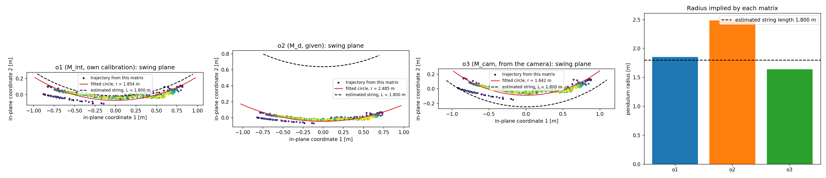
Q1(c): Swing plane and radius
Matrix | Fitted radius | Diff. to 1.80 m | Circle-fit RMS
o1 own | 1.854 m | +54 mm | 36.7 mm
o2 given | 2.485 m | +685 mm | 23.7 mm
o3 camera | 1.642 m | −158 mm | 44.5 mm
• SVD gives the swing plane; a circle fitted in it gives the radius
• Estimated string length: 1.80 m. o1 is closest
• o2 is too large: its scale is wrong, so the arc is stretched

Slide 6
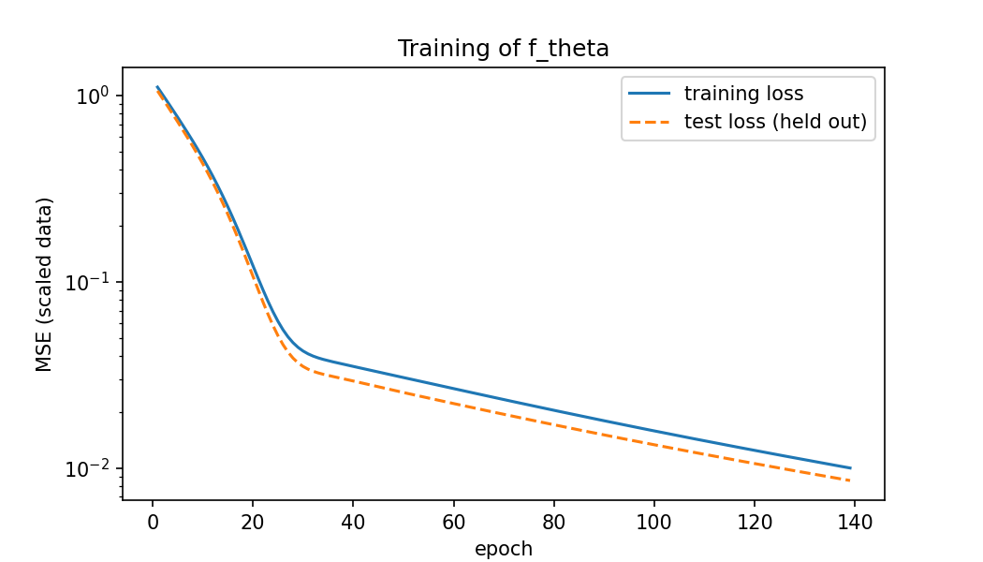
Q1(d): Network from o1 to o2
Setting | Value
Input / output | o1 (X, Y, Z) → o2 (X, Y, Z)
Network | 2 hidden layers of 16, tanh
Solver | Adam, one epoch at a time
Scaling | Inputs and outputs standardized
Train / test split | 80 / 20 %, fixed seed
Epochs | 300 (stop limit not reached)
• Training and test loss follow each other, so no overfitting
• Final loss 1.7e-3 (training) and 1.6e-3 (test), still falling slowly
• o2 is a linear function of o1, so the network only has to find a scaling and an offset
Loss during training (log scale)

Slide 7
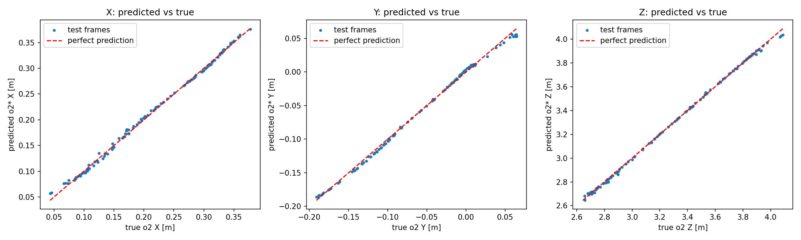
Q1(d): Accuracy on the test frames
Predicted o2* against true o2, test frames only
Test set | RMSE | MAE | R²
X | 4.3 mm | 3.4 mm | 0.9979
Y | 3.5 mm | 2.7 mm | 0.9977
Z | 12.8 mm | 8.1 mm | 0.9992
• Points lie on the red line: the network has learned the mapping
• Z is worst in mm, although it is identical in o1 and o2: a sign that training is not fully converged

Slide 8
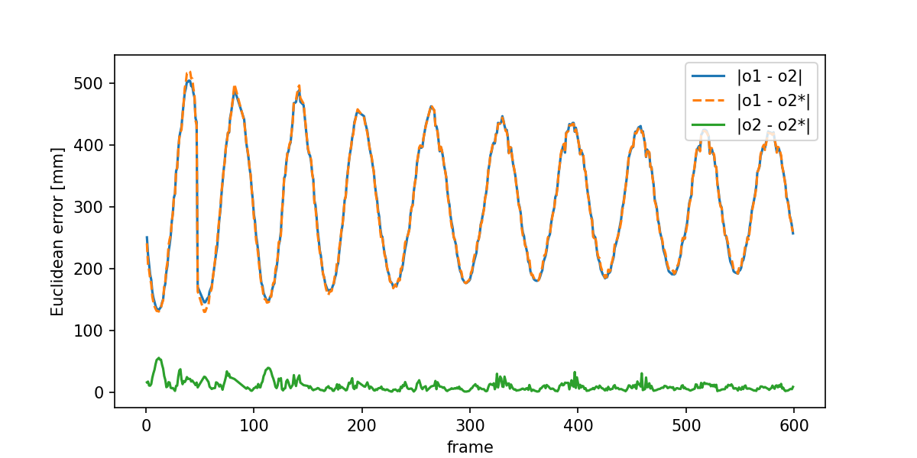
Q1(e): Euclidean errors
Error (552 frames) | Mean | Median | Max
|o1 − o2| | 301.1 mm | 297.1 mm | 504.5 mm
|o1 − o2*| | 301.3 mm | 294.8 mm | 519.9 mm
|o2 − o2*| | 9.6 mm | 6.7 mm | 55.3 mm
• o2* is as far from o1 as o2 is (about 301 mm), so it is a good copy of o2
• The network is wrong by about 10 mm on average, 30 times less than the gap it bridges
• Largest errors are at the start (up to 55 mm)
Error between the trajectories, per frame

Slide 9
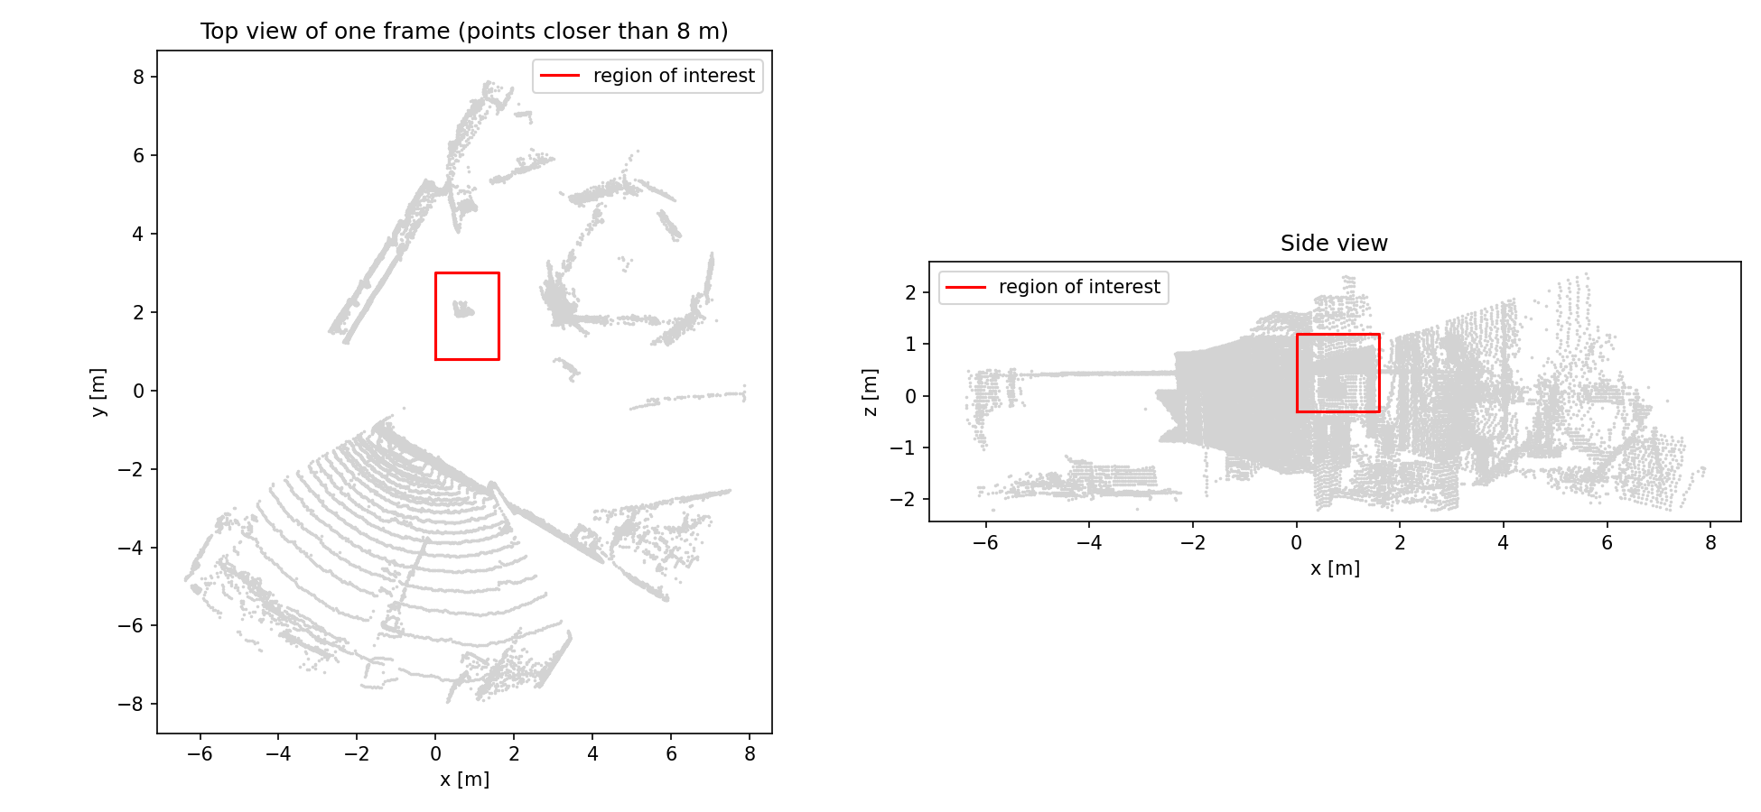
Q2(a): Finding the centre of the load
• Ouster OS-1-64, 99 frames at 10 Hz, converted to x, y, z points
• ROI box around the load: x 0–1.6 m, y 0.8–3.0 m, z −0.3–1.2 m
• DBSCAN (eps 0.08 m, min 10 points) keeps the biggest cluster = the load
• Sling and hook removed: only the lowest 0.30 m of the cluster is kept
• Centre = mean of the remaining points
Lidar points of the load inside the search box (ROI)
• Why the centroid: it uses all points, so it is smooth and has no drift

Slide 10
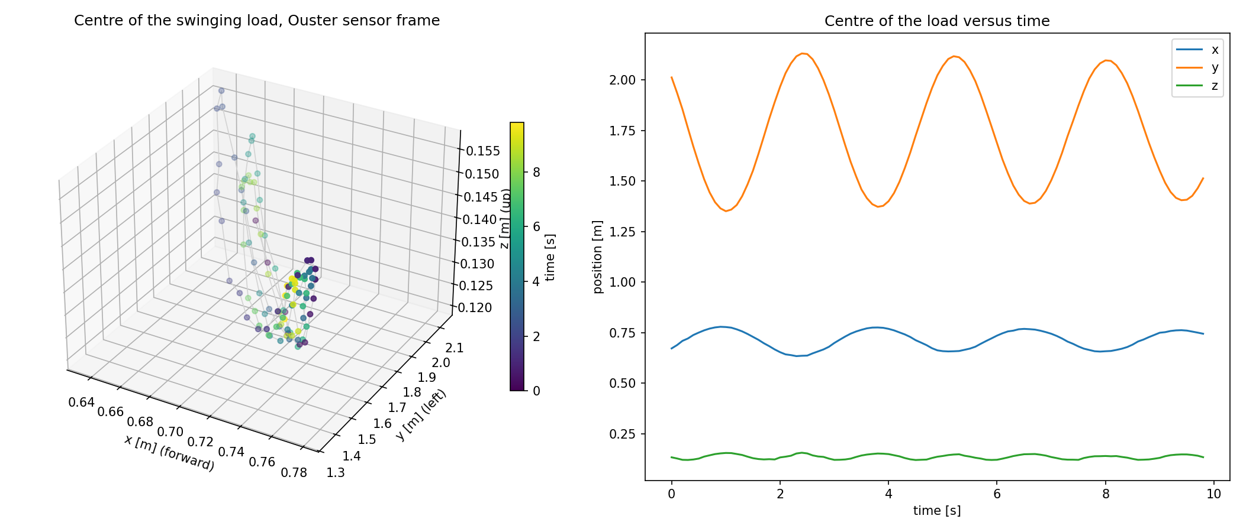
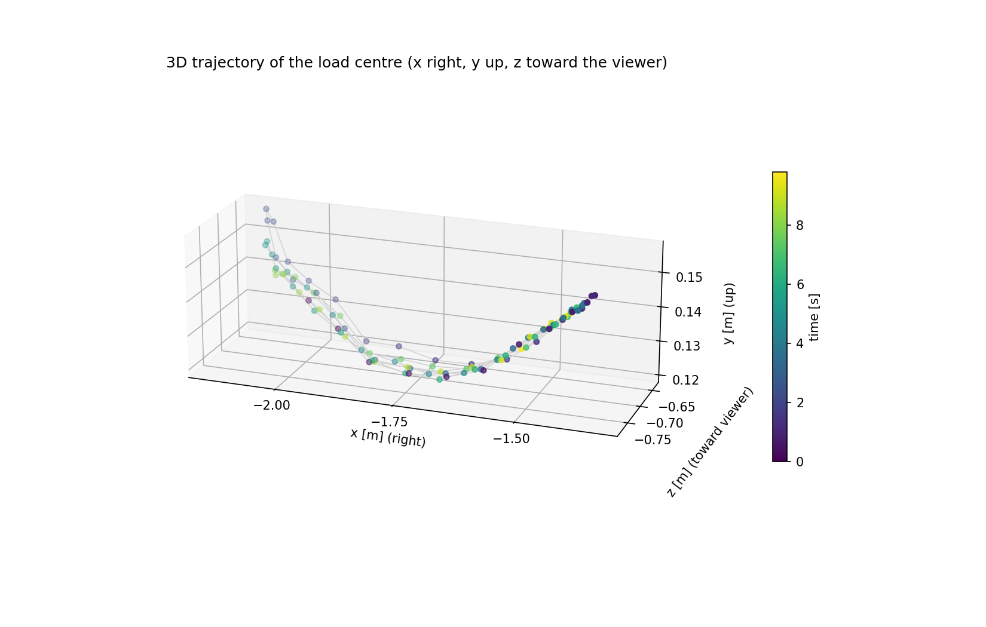
Q2(a): A pendulum swing
Centre of the swinging load (3D and versus time)
Path in the axes of the assignment
• Swing period 2.80 s from a sinusoid fit, so L = g T² / (4π²) ≈ 1.95 m
• Noise of the centroid with a still load: 0.5 / 0.9 / 0.5 mm (x / y / z)
• This gives us a clean reference to judge KISS-ICP against

Slide 11
Q2(b): KISS-ICP
1 Downsample
voxel grid on each scan
2 Predict
constant-velocity guess of the move
3 Align (ICP)
scan to local map, point to point
4 Update
add scan to map, adapt threshold
Principle
• Odometry from lidar only: each new scan is matched to a map of the earlier scans
• The map is a voxel grid, so it stays small and fast
• Match distance limit adapts to how fast things move
Used for
• Cars and robots: pose without GPS
• Mapping and localization where only a lidar is available
Drawbacks
• Assumes the sensor moves in a fixed world (here the load moves, so we invert the pose)
• Constant speed assumed; drifts without loop closure
• Needs good geometry: a small object seen from one side is weak

Slide 12
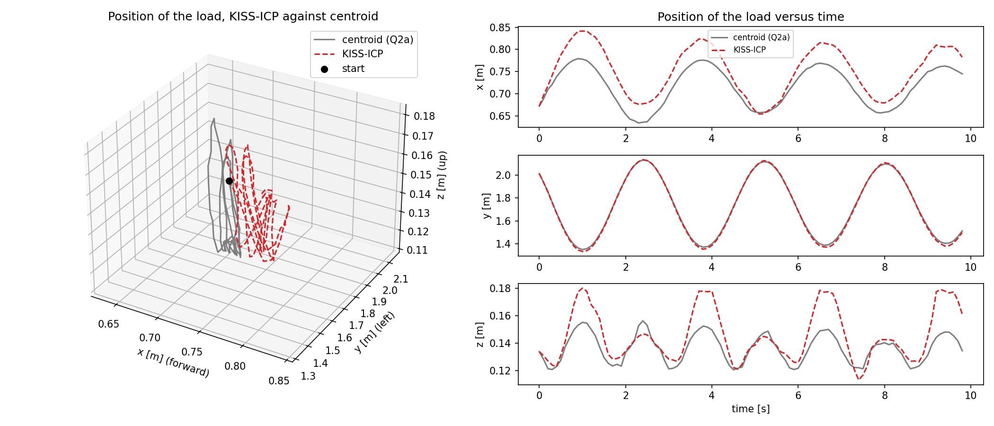
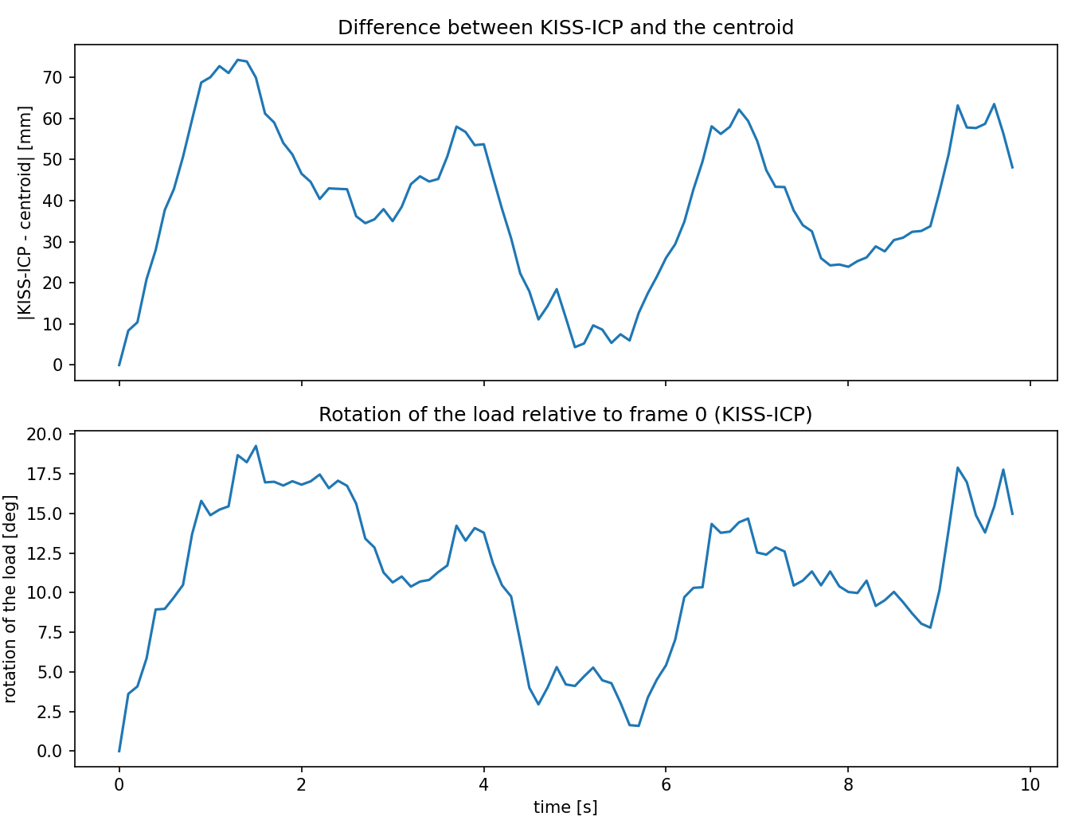
Q2(b): KISS-ICP vs the centroid
KISS-ICP position against the centroid (Q2a)
Difference and rotation
• Settings scaled down for a 0.3 m object: voxel 0.02 m, range 0–10 m, no deskew
• Difference to the centroid: mean 39.0 mm, max 74.3 mm, RMS 43.2 mm
• Pose of the load = inverse of the KISS-ICP sensor pose

Slide 13
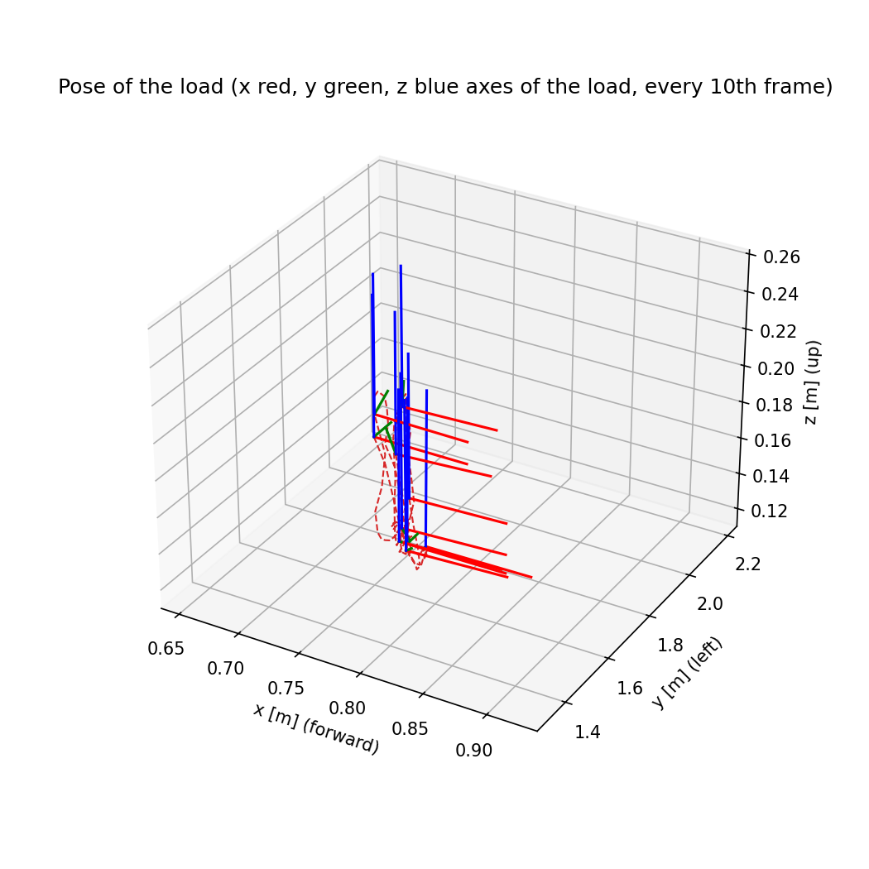
Q2(b): Pose and what to trust
• Position follows the swing well: errors are millimetres to a few cm
• Rotation reaches 19.3°: part of it is real (the load turns about ±11° while swinging), part is drift
• The x amplitude is about 17 % larger than the centroid's
• Only one side of the object is seen, so rotation is weakly determined
• Neither method is ground truth; the centroid is the better position reference, KISS-ICP is the only one with orientation
Load pose (x red, y green, z blue), every 10th frame

Slide 14
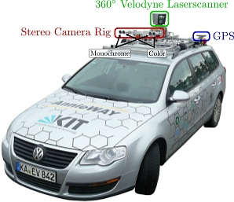
Q3(a): KITTI sensors
Cameras (4): cam0/cam1 grayscale pair, cam2/cam3 color pair.
Lidar: Velodyne HDL-64E: 64 laser beams, 360° around the car, 10 Hz, typically 100 000–125 000 points per scan
GPS/IMU: Position and motion of the car (not needed in this task)
Synchronized: The lidar triggers the cameras, so one frame = one moment
This task uses cam2 (left color camera) + the lidar
KITTI: an open benchmark dataset, recorded from a car driving around in Germany. Retrieved from: https://www.cvlibs.net/datasets/kitti/

Slide 15
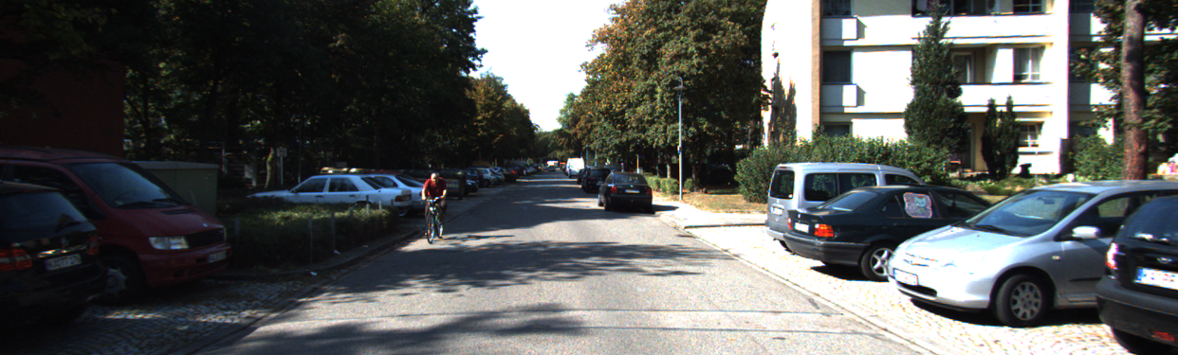
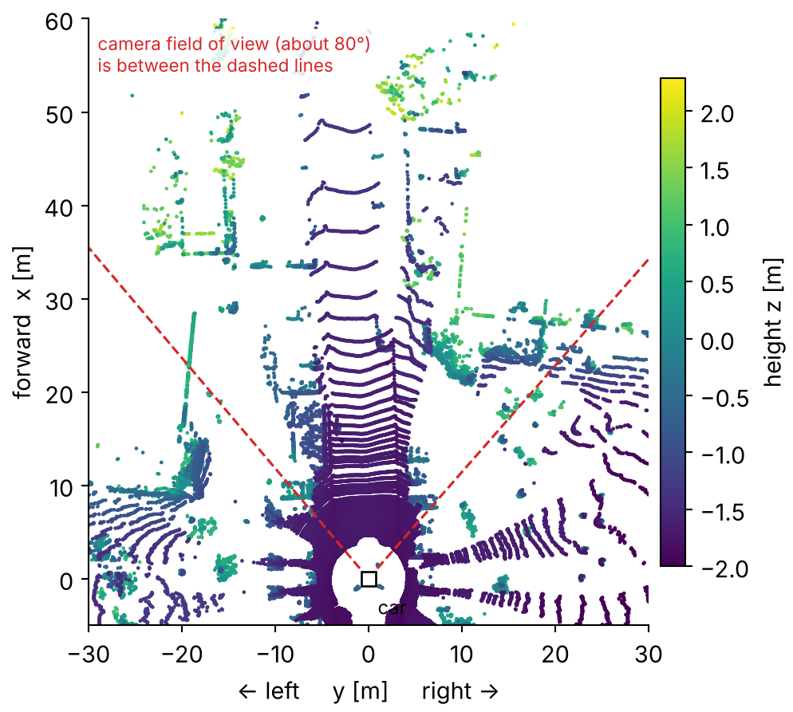
Q3(a): One frame, two views
Camera (cam2): what the scene looks like, frame 006942
• Lidar scan = a point cloud: 109 578 points around the whole car, each with x, y, z and reflectance
• Only 18 351 of them (17 %) land inside the camera image: the camera sees forward only
• Camera: color and detail, but no depth. Lidar: depth, but no color
• Both show the same cars, at the same moment
Point cloud (velodyne/006942.bin) from above, colored by height

Slide 16
Q3(a): Calibration files
Tr_velo_to_cam
lidar → camera
Says where the lidar sits compared to the camera (about 8 cm above and 27 cm behind it), so lidar points can be moved into the camera's view
R0_rect
small correction
A tiny rotation that lines the cameras up with each other. It is almost "do nothing"
P2
camera → pixels
Describes the camera itself: the focal length and where the center of the image is. It turns a 3D point into a pixel
Why it matters: without these files a lidar point cannot be placed on the right pixel. Every frame has its own calibration file.

Slide 17
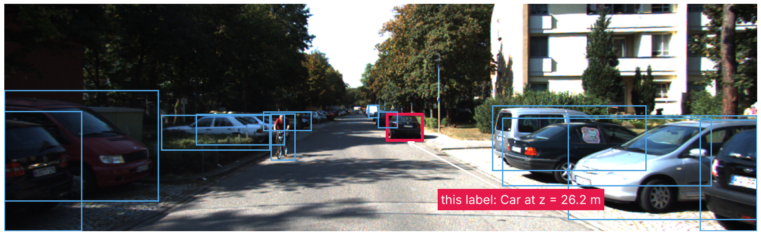
Q3(a): Labels = ground truth
Frame: 006942
• Each frame has a label file: one line per object
• This frame: 13 objects (11 cars, 1 van, 1 cyclist) + 2 DontCare regions
• Humans marked each object in 2D (box in the image) and 3D (size, position)
• The 3D position gives the true distance, so we can check our lidar estimate

Slide 18
Q3: Why fuse camera and lidar?
Goal: know what is around the vehicle and how far away it is
Camera: projects the 3D scene onto a 2D image, so depth is lost (but it shows WHAT: color, shape, class)
Lidar: measures HOW FAR with 3D points, but not what the object is
Fusion links the two: every detected object gets a distance
Camera
WHAT: color, texture, class
no distance
Lidar
WHERE: exact 3D distance
no color, sparse points
Fusion
WHAT and HOW FAR
object + distance
+

Slide 19
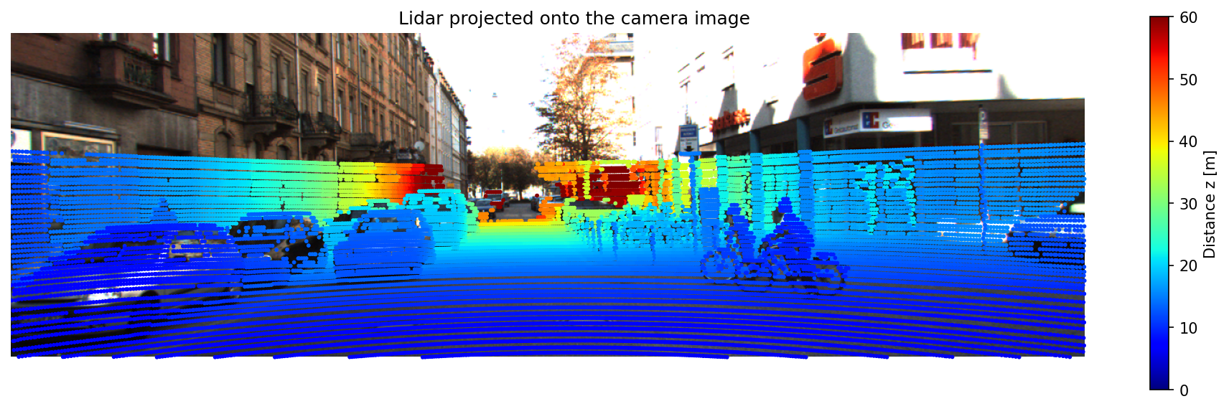
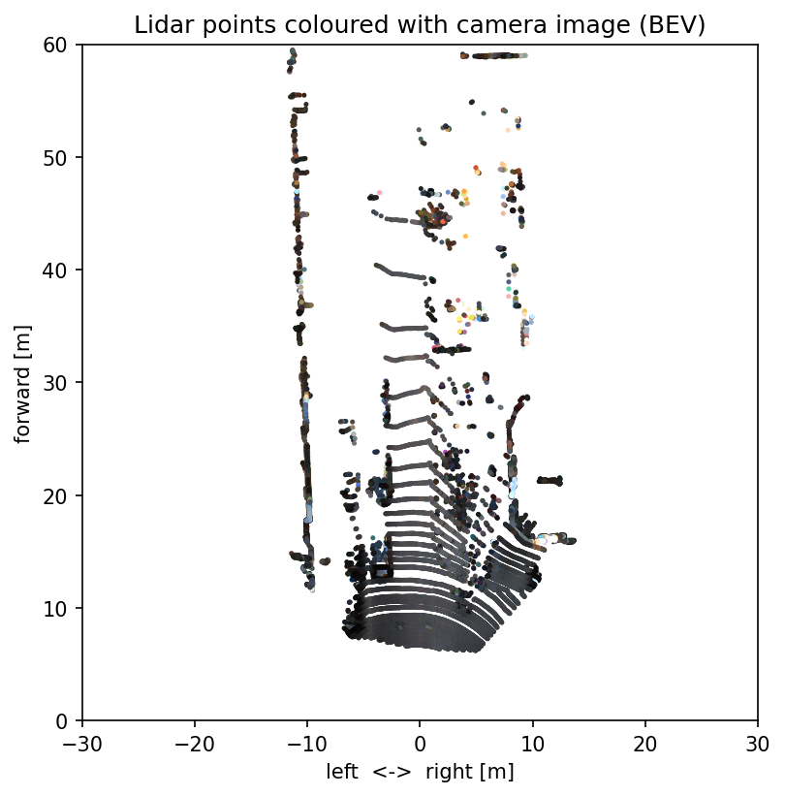
Q3(b)(i): Lidar and camera, both ways
Lidar projected onto the camera image (frame 001100), color = distance z
Lidar → image: every 3D point goes through Tr_velo_to_cam, R0_rect and P2 and lands on a pixel. Near points are blue, far points are red
Image → lidar: the same pixel gives the point its color. Because the calibration is correct, the colors fit the shapes: cars, trees and the building wall
Vice versa: lidar points colored with the image colors, seen from above

Slide 20
Q3(b): How we measure the distance
1 Project
lidar → pixels
2 Detect
YOLO boxes
3 Cluster
DBSCAN per box
4 Distance
center of the object cluster
Example: the car at 26.2 m
Label: 26.2 m
Lidar estimate: 24.3 m
Difference −1.9 m ≈ half the car length (4.08 m / 2)
Lidar hits the back of the car, the label marks its center
Detect (YOLO): We used YOLO, which gives boxes, classes and confidence. We keep cars, trucks, people and cyclists with confidence ≥ 0.4. We use it as it is, without training
Cluster: inside each YOLO box, the lidar points that lie close together (DBSCAN) form one object. Points on the wall behind the car form another cluster and are ignored
Distance: the middle of the cluster gives the distance z

Slide 21
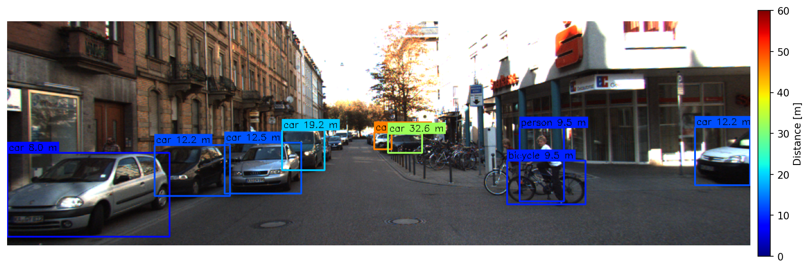
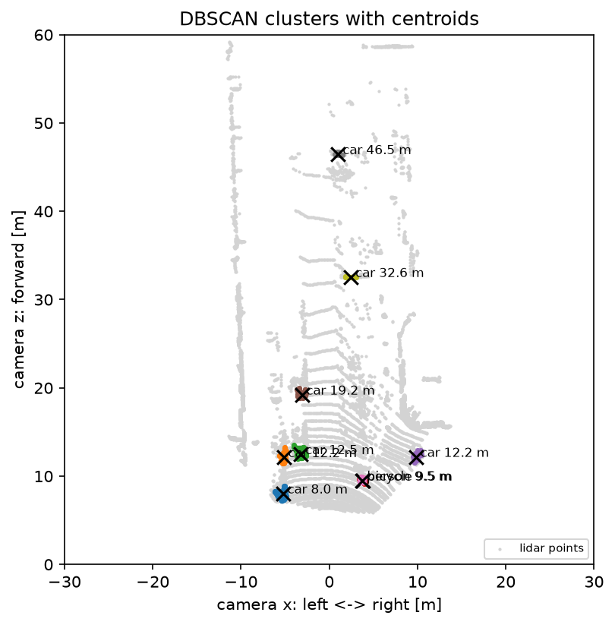
Q3(b)(ii): Detection + lidar distance
YOLO boxes, color and label = lidar distance (frame 001100)
Boxes: YOLO finds 7 cars, a bicycle and a person; each box gets the distance of its lidar cluster, e.g. 8.0 m for the nearest car
Clusters: inside each box the lidar points that lie close together form one cluster. The centroid (×) gives the distance
Far objects: a car at 46.5 m has only 9 lidar points, but it is still found (error −0.55 m)
DBSCAN clusters (colors) with centroids (×), top view

Slide 22
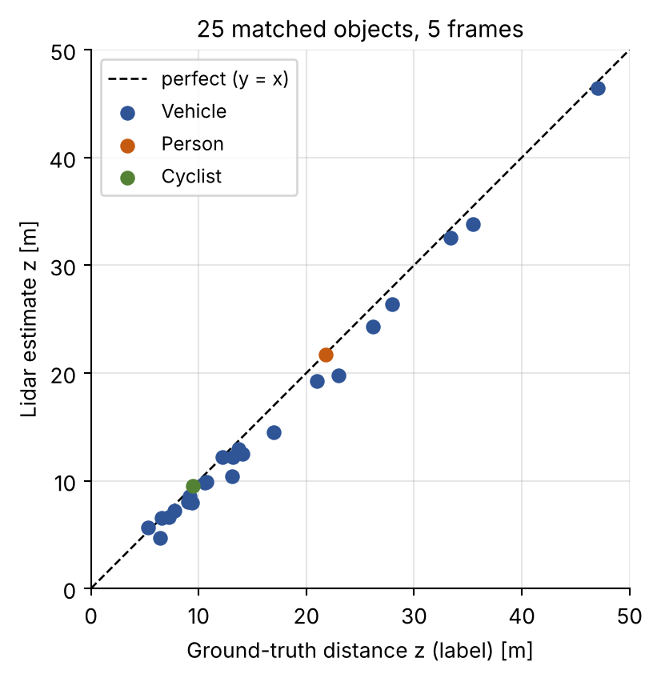
Q3(b)(iii): Validation
Metric (25 objects, 5 frames) | Value
Mean absolute error (MAE) | 1.11 m
RMSE | 1.40 m
Bias (estimate − label) | −1.09 m
Relative error | 8.0 %
Within 1 m / within 2 m | 14 / 22 of 25
Negative errors | 22 of 25
Small objects: person −0.06 m, cyclist +0.01 m, because they are thin
Worst case: −3.2 m, a car with a poor box match
Limit: we only validate objects that YOLO found (recall is not measured)
Points below the dashed line: lidar closer than the label

Slide 23
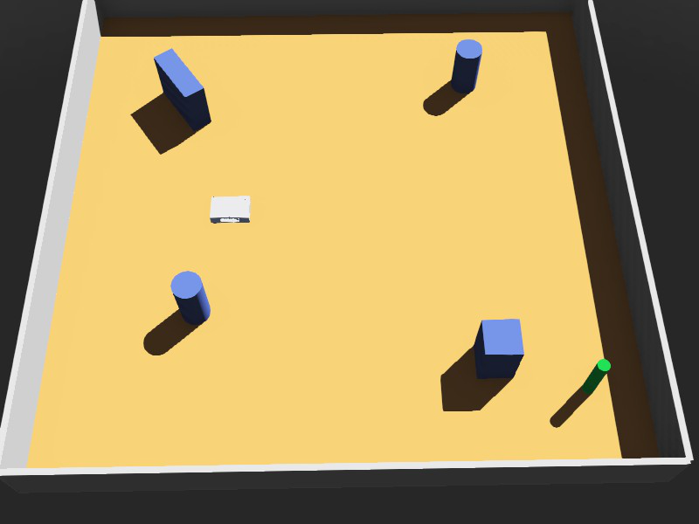
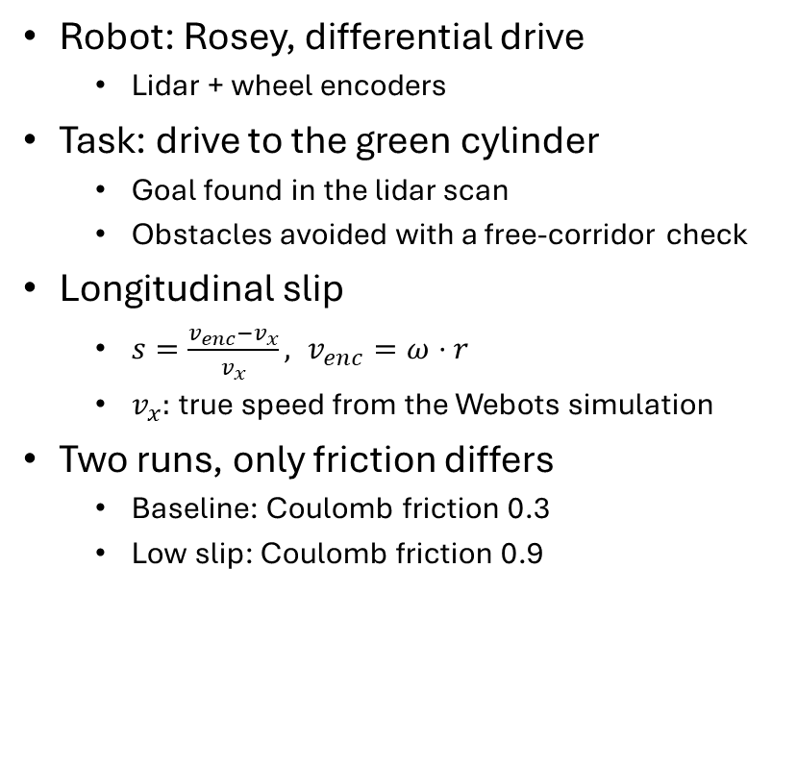
Q4: Navigation and slip estimation
Robot: Rosey, differential drive
  Lidar + wheel encoders
Task: drive to the green cylinder
  Goal found in the lidar scan
  Obstacles avoided with a free-corridor check
Longitudinal slip
  $s=\frac{v_{enc}−v_{x}}{v_{x}}, v_{enc}=ω⋅r$
  $v_{x}:$true speed from the Webots simulation
Two runs, only friction differs
  Baseline: Coulomb friction 0.3
  Low slip: Coulomb friction 0.9

Slide 24
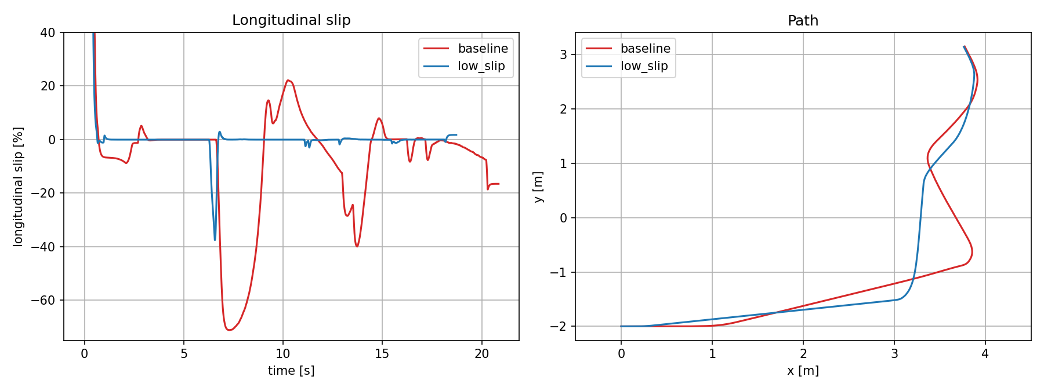
Q4: Slip results
• Baseline (μ = 0.3): slip swings from +22 % to −71 %, mostly when the robot brakes for the target
• Low slip (μ = 0.9): slip stays near 0 apart from one short braking spike
• With low friction the wheel speed no longer matches the true speed, so encoder odometry is unreliable
Metric | Baseline (μ = 0.3) | Low slip (μ = 0.9)
Time to goal | 21.7 s | 19.6 s
Mean slip | −8.3 % | −0.6 %
Mean |slip| | 11.9 % | 0.7 %
Peak slip | −71 % | −38 %
Time with |slip| < 5 % | 51 % | 98 %

